Slide 1


 | Nitte Meenakshi Institute of Technology (AN AUTONOMOUS INSTITUTION AFFILIATED TO VISVESVARAYA TECHNOLOGICAL UNIVERSITY, BELGAUM) PB No. 6429, Yelahanka, Bangalore 560-064, Karnataka Telephone: 080- 22167800, 22167860, Fax: 080 - 22167805
Department of Computer Science and Engineering
Movie Recommendation System using Machine Learning
P20CS53
PHASE 3
Presentation By:
Karthik G 1NT17CS082
Kishore Kumar A R 1NT17CS094
K V Dharma Teja 1NT17CS095
Nagaraju P 1NT17CS110
Guided By:
Guide Name:Dr. Shiva Darshan S L
Designation:
Asst. professor Dept. of CSE, NMIT

Slide 2
Overview
 | Nitte Meenakshi Institute of Technology (AN AUTONOMOUS INSTITUTION AFFILIATED TO VISVESVARAYA TECHNOLOGICAL UNIVERSITY, BELGAUM) PB No. 6429, Yelahanka, Bangalore 560-064, Karnataka Telephone: 080- 22167800, 22167860, Fax: 080 - 22167805
Department of Computer Science and Engineering
Background Research Motivation Literature Survey . Problem Statement Research Objective Requirements Incorporation of changes mentioned in phase 2 Design Implementation Result Conclusion References

Slide 3
 | Nitte Meenakshi Institute of Technology (AN AUTONOMOUS INSTITUTION AFFILIATED TO VISVESVARAYA TECHNOLOGICAL UNIVERSITY, BELGAUM) PB No. 6429, Yelahanka, Bangalore 560-064, Karnataka Telephone: 080- 22167800, 22167860, Fax: 080 - 22167805
Department of Computer Science and Engineering
Background
Movie recommendation system is one of the top research areas, currently. Due to the impact of high internet speeds, multimedia has become one of the best entertainments.
With the rapid development of Internet technology today's society has entered the era of Web 2, information overload has become a reality
Movie streaming services are increasingly used by consumers to enjoy video content.
For example, in 2017 Netflix subscribers collectively watched more than 140 million hours per day and Netflix surpassed $11 billion in revenue in 2017.
Movie is one of the main spiritual entertainment, also has the problem of information overload.

Slide 4
 | Nitte Meenakshi Institute of Technology (AN AUTONOMOUS INSTITUTION AFFILIATED TO VISVESVARAYA TECHNOLOGICAL UNIVERSITY, BELGAUM) PB No. 6429, Yelahanka, Bangalore 560-064, Karnataka Telephone: 080- 22167800, 22167860, Fax: 080 - 22167805
Department of Computer Science and Engineering
Background Contd.
The proposed work deals with the introduction of various concepts related to recommendation system.
The mission of Recommender System is to provide win-win situation for both customers and content providers.

Slide 5
 | Nitte Meenakshi Institute of Technology (AN AUTONOMOUS INSTITUTION AFFILIATED TO VISVESVARAYA TECHNOLOGICAL UNIVERSITY, BELGAUM) PB No. 6429, Yelahanka, Bangalore 560-064, Karnataka Telephone: 080- 22167800, 22167860, Fax: 080 - 22167805
Department of Computer Science and Engineering
Research motivation
In this hustling world, entertainment is a necessity for each one of us to refresh our mood and energy.
Recommendation systems are getting increasingly important in today’s extraordinarily busy world.
People are always short on time with the myriad duties they need to accomplish within the restrained 24 hours.
The reason for a recommendation system essentially is to look for content that would be thrilling and exciting to an individual.
Moreover, it includes a number of things to create customized lists of beneficial and exciting content unique to every user/individual.
Therefore, the movie recommendation System are vital as they help users
make the right choices without having to dissipate their cognitive resources.

Slide 6
 | Nitte Meenakshi Institute of Technology (AN AUTONOMOUS INSTITUTION AFFILIATED TO VISVESVARAYA TECHNOLOGICAL UNIVERSITY, BELGAUM) PB No. 6429, Yelahanka, Bangalore 560-064, Karnataka Telephone: 080- 22167800, 22167860, Fax: 080 - 22167805
Department of Computer Science and Engineering
Literature Survey
SL.NO | Method | Description | References
1. | Collaborative Filtering | Recommendation system is to provide prediction of the different items in which a user would be interested in based on their preferences. | Mukesh Kumar Kharita; Atul Kumar Pardeep Singh
2. | Multinomial Naïve Bayes | The input dataset consists of a compilation of a number of tweets which expresses the thoughts of various people about different election candidates who compete in the election. | Prabha PM Surya Lakshmi V Seetha; B Subbulakshmi
3. | Semi-Supervised learning approaches | The recommendation system or recommendation engine, considered here in paper, that help a person in identifying significant and possible services or products of interest based on the preferences given by him/her. | Sushmita Roy; Mahendra Sharma; Santosh Kumar Singh.

Slide 7
4. | Support Vector Machine | A Sentiment analysis system is built based on the TMDB dataset and used SVM to predict positive negative sentiment from the user's movie review and then movies are rated based on the sentiment analysis and scoring of the reviews. | Nimish Kapoor; Saurav Vishal; Krishnaveni. K.S
5. | Multinomial and Bernoulli Naïve Bayes | Prediction of whether the sentiment of the news article is positive or negative using the two popular approaches of Naïve Bayes Text Categorization i.e. Multivariate Bernoulli Naïve Bayes Classification and Multinomial Naïve Bayes Classification. | Gurinder Singh; Bhawna Kumar; Loveleen Gaur; Akriti Tyagi
6. | K-Means and TF-IDF | Here a cluster or group which is a set of tweets that are created by different users on the Twitter website were developed and intimated to the user about the behavior which is mainly focusing on sentimental analysis. | K Sai Madhu; B Chakradhar Reddy; CH Damarukanadhan
7. | Cosine Similarity | An algorithm is proposed that extract the main content from the web documents. The algorithm based on Content Structure Tree (CST). Firstly, the proposed system use HTML Parser to construct DOM tree from which construct CST which can easily separate the main content blocks from the other blocks. | Swe Swe Nyein.

Slide 8
 | Nitte Meenakshi Institute of Technology (AN AUTONOMOUS INSTITUTION AFFILIATED TO VISVESVARAYA TECHNOLOGICAL UNIVERSITY, BELGAUM) PB No. 6429, Yelahanka, Bangalore 560-064, Karnataka Telephone: 080- 22167800, 22167860, Fax: 080 - 22167805
Department of Computer Science and Engineering
8. | Hybrid filtering | The purpose to use movie tweets is to understand the current trends, public sentiment, and user response of the movie. Experiments conducted on the public database have yielded promising results. | Sudhanshu Kumar; Kanjar De; Partha Pratim Roy.
9. | Naïve Bayes | We have used few learning algorithms to effectively rate the faculty belonging to an educational institute on the basis of feedback submitted by the students. | K. S. Krishnaveni; Rohit R Pai; Vignesh Iyer.
10. | Deep learning method | we propose a deep learning approach based on autoencoders to produce a collaborative filtering system which predicts movie ratings for a user based on a large database of ratings from other users. | Jeffrey Lund ;Yiu-Kai Ng.

Slide 9
 | Nitte Meenakshi Institute of Technology (AN AUTONOMOUS INSTITUTION AFFILIATED TO VISVESVARAYA TECHNOLOGICAL UNIVERSITY, BELGAUM) PB No. 6429, Yelahanka, Bangalore 560-064, Karnataka Telephone: 080- 22167800, 22167860, Fax: 080 - 22167805
Department of Computer Science and Engineering
Research objectives
To develop a movie recommendation system with the improved efficiency to recommend the movie better than the existing model.
To design a movie recommendation system that provide a mechanism to assist users in classifying users with similar interests.
Implementation of movie recommendation system using sentimental analysis to classify the reviews and recommend movies.
Analysis of the performance of the proposed movie recommendation system using standard performance metrics.

Slide 10
 | Nitte Meenakshi Institute of Technology (AN AUTONOMOUS INSTITUTION AFFILIATED TO VISVESVARAYA TECHNOLOGICAL UNIVERSITY, BELGAUM) PB No. 6429, Yelahanka, Bangalore 560-064, Karnataka Telephone: 080- 22167800, 22167860, Fax: 080 - 22167805
Department of Computer Science and Engineering
Problem statement
“Design and development of a movie recommendation system that uses the users input and suggest movies to the users based on similar tastes and interests using sentimental analysis.”

Slide 11
 | Nitte Meenakshi Institute of Technology (AN AUTONOMOUS INSTITUTION AFFILIATED TO VISVESVARAYA TECHNOLOGICAL UNIVERSITY, BELGAUM) PB No. 6429, Yelahanka, Bangalore 560-064, Karnataka Telephone: 080- 22167800, 22167860, Fax: 080 - 22167805
Department of Computer Science and Engineering
Hardware Requirements
REQUIREMENTS
Name of Component | Specification
Processor | 1,6 GHz CPU
RAM | 4 GB RAM
HDD | 1x 20 GB of free space or more

Slide 12
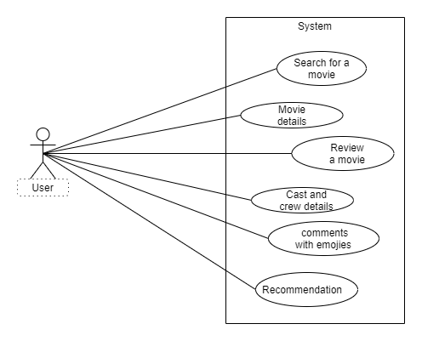
Functional Requirements
Figure 1: Use case diagram explaining the functional requirements of movie recommendation system

Slide 13
 | Nitte Meenakshi Institute of Technology (AN AUTONOMOUS INSTITUTION AFFILIATED TO VISVESVARAYA TECHNOLOGICAL UNIVERSITY, BELGAUM) PB No. 6429, Yelahanka, Bangalore 560-064, Karnataka Telephone: 080- 22167800, 22167860, Fax: 080 - 22167805
Department of Computer Science and Engineering
Non-functional Requirements
Usability : The model should have a clean interface with simple design that can is easily usable.
Availability : The recommendation made will be accurate 24X7 and the content will be accessible from anywhere at anytime.
Scalability : However large the dataset might be, it gives the accurate prediction.
Performance : This project has very high performance even though datasets are very huge.
Supportability : The project will run on Windows, Linux as as well other major operating systems.
Cost effective : As we use no hardware devices we are producing a cost effective model.

Slide 14
Incorporation of changes mentioned in phase 2
SL.No | Requirements | Status
1. | Sentiment Analysis | Completed
2. | Translation to the regional language | Completed
3. | Blog to write reviews | Completed
4. | Background | Completed
5. | Trailer Video | Completed
6. | Heroku Cloud | Completed

Slide 15
Req1 - Sentiment analysis :-
The primary job in sentimental analysis is to classify the polarity of a given review/text in a paragraph or sentence as whether the expressed feature of the sentence is positive, negative by using NLP and text analysis.
Now a days, users provide their feedback, comment or text reviews to the items in many e-commerce or social networking services. These user’s provide feedback or text data contain numerous amount of sentimental opinion towards the item.
Sentiment analysis is implemented using python gives the output where the text review or sentence is either positive or negative.

Slide 16
Req2 - Adding Languages :-
We have added a number of languages apart from English, which include regional, national and international languages.
User can read view the whole content of the page in which ever language he wants.
This feature helps a wide range of users who are only restricted to their regional language.
Req3 - Blog :-
A blog is created using which the users can write their reviews.
This will help us to increase our database and in turn get better results.
Req4 - Background of Webpage :-
The background of the webpage is garnered with the NMIT college picture.

Slide 17
Req5 - Trailer Video :-
A video is also added in the description of the movie where a user can see the trailer of the movie.
The user need not go elsewhere. to see the trailer of the movie.
The trailer will provide the required visual scenes of the movie
Req6 - Heroku Cloud Platform :-
Our project is being deployed in the Heroku cloud platform for easy use and availability.
Heroku is a container-based cloud Platform as a Service (PaaS). Developers use Heroku to deploy, manage, and scale modern apps.

Slide 18
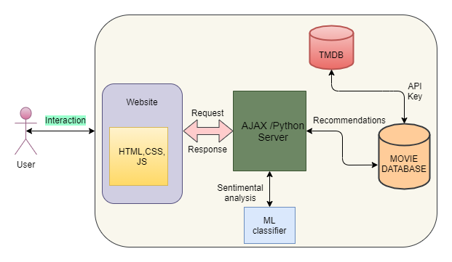
 | Nitte Meenakshi Institute of Technology (AN AUTONOMOUS INSTITUTION AFFILIATED TO VISVESVARAYA TECHNOLOGICAL UNIVERSITY, BELGAUM) PB No. 6429, Yelahanka, Bangalore 560-064, Karnataka Telephone: 080- 22167800, 22167860, Fax: 080 - 22167805
Department of Computer Science and Engineering
Design
Figure 2: Architecture Diagram

Slide 19

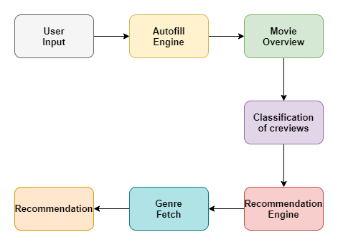
Data Flow Diagram
Figure 3: Data flow diagram of movie recommendation system

Slide 20
 | Nitte Meenakshi Institute of Technology (AN AUTONOMOUS INSTITUTION AFFILIATED TO VISVESVARAYA TECHNOLOGICAL UNIVERSITY, BELGAUM) PB No. 6429, Yelahanka, Bangalore 560-064, Karnataka Telephone: 080- 22167800, 22167860, Fax: 080 - 22167805
Department of Computer Science and Engineering
Implementation
We have successfully created a website with search engine which has auto-complete functionality.
This system also incorporates movie cast, genre, rating, release date, runtime, status as well as the overview.
In order to increase the amount of available data we have collected and integrated database from TMDB which now results in a database containing all movies till 2020.
User will get maximum information related to a movie along with their description and in any language they desire.

Slide 21
Contd…
User will get a set of recommended movies according to their input.
The background of the webpage is garnered with the NMIT college picture.
Users can also add their own reviews of the movie in the blog which is created.
The already existing comment reviews are classified into one word along with an emoji – either “Good” or “Bad” using Sentiment Analysis.
The primary job in sentimental analysis is to classify the polarity of a given review/text in a paragraph or sentence as whether the expressed feature of the sentence is positive, negative by using NLP and text analysis.

Slide 22
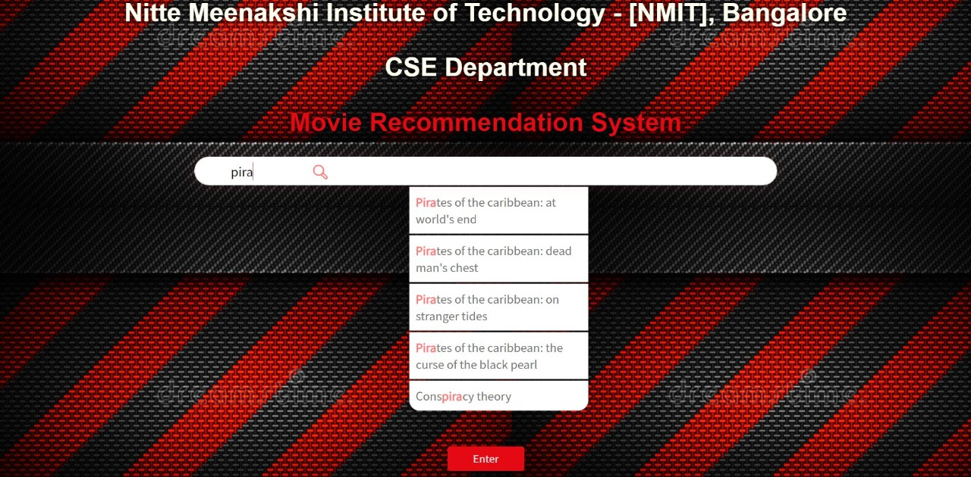
Results
Figure 4: Search bar with auto fill feature

Slide 23
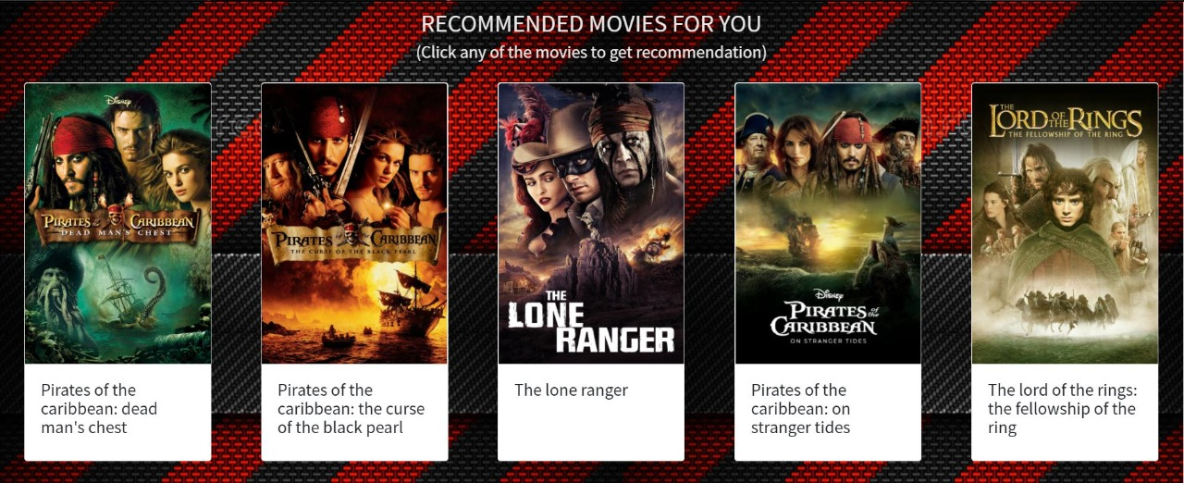
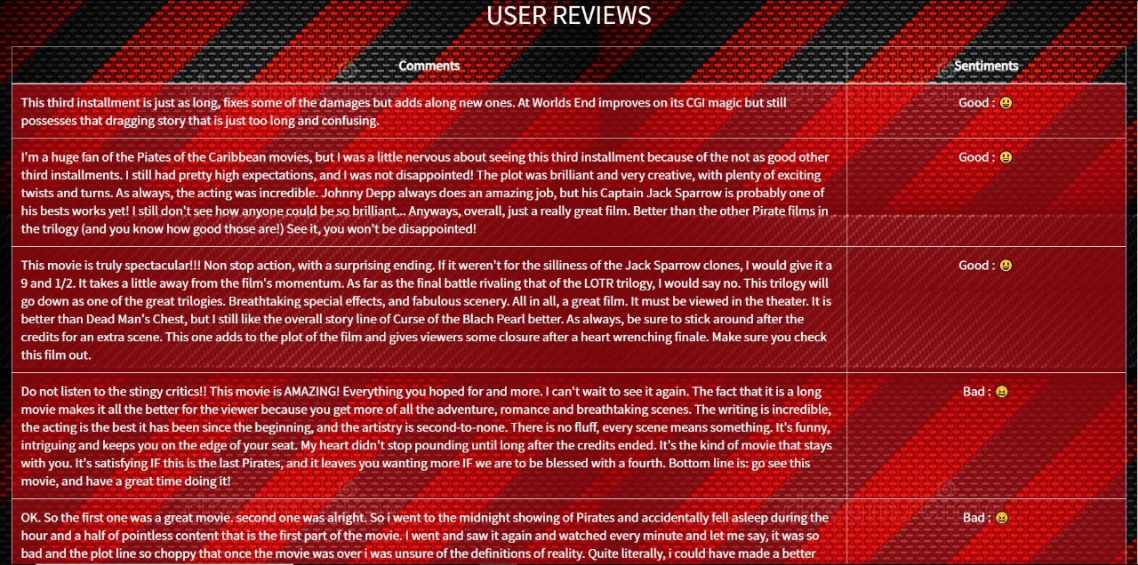
Figure 5: Recommended Movies
Figure 6: Sentiment Analysis of reviews

Slide 24
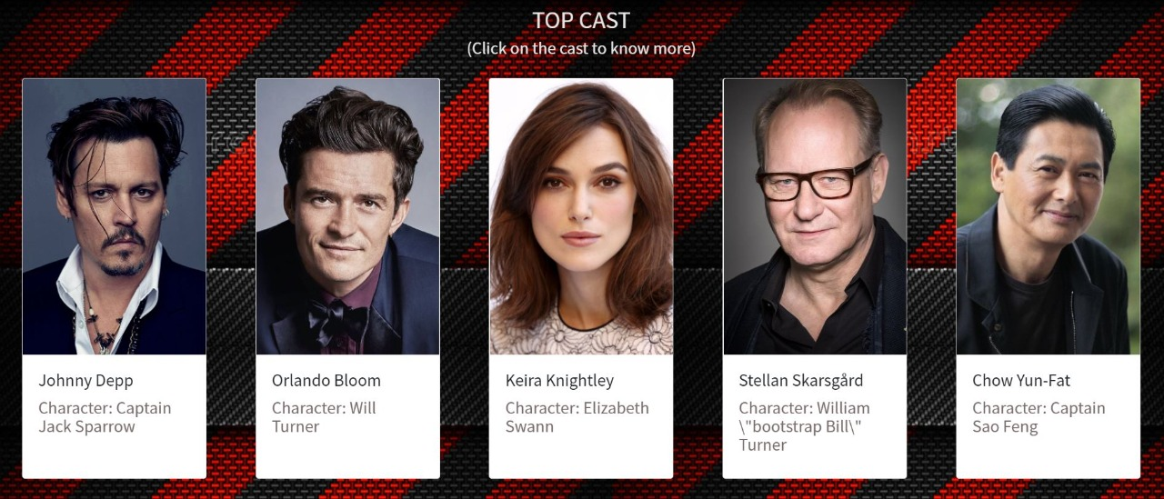
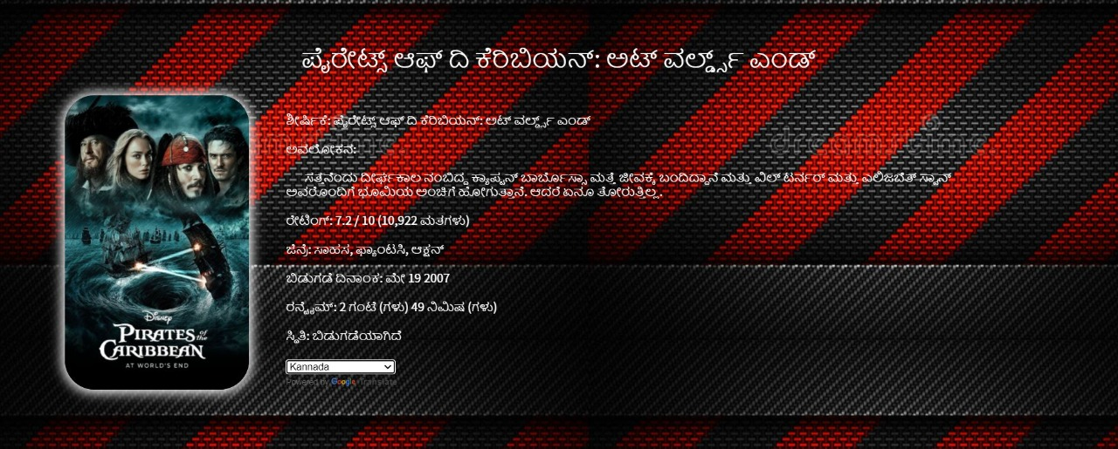
0
Figure 7: Top Cast of the movie
Figure 8: Content in regional language

Slide 25
 | Nitte Meenakshi Institute of Technology (AN AUTONOMOUS INSTITUTION AFFILIATED TO VISVESVARAYA TECHNOLOGICAL UNIVERSITY, BELGAUM) PB No. 6429, Yelahanka, Bangalore 560-064, Karnataka Telephone: 080- 22167800, 22167860, Fax: 080 - 22167805
Department of Computer Science and Engineering
Conclusion
This recommendation system recommends different movies to users.
For recommender system specifically, we found out that Cosine Similarity classifier is the best one among all the machine learning classifiers.
We have created a web application that allows users to review the movies as well as recommends them appropriate movie based on their search input.
Sentiment Analysis of the reviews demonstrates whole review in a single word with an emoji i.e either “Good” or “Bad. This helps user save their precious time instead of reading the whole review.
Movie Recommendation systems proved themselves to be a best solution for addressing problem of the information overload.
Future work will focus on enhancement of the existing methods and algorithms used so that the recommendation systems predictions and recommendations quality can be improved.

Slide 26
 | Nitte Meenakshi Institute of Technology (AN AUTONOMOUS INSTITUTION AFFILIATED TO VISVESVARAYA TECHNOLOGICAL UNIVERSITY, BELGAUM) PB No. 6429, Yelahanka, Bangalore 560-064, Karnataka Telephone: 080- 22167800, 22167860, Fax: 080 - 22167805
Department of Computer Science and Engineering
References
[1]Muppana Mahesh Reddy ,Sujithra and Dr. B. Surendiran “Analysis of Movie Recommendation Systems with and without considering the low rated movies” 2020 International Conference on Emerging Trends in Information Technology and Engineering (ic-ETITE)
[2] P.P Gokul;B K Akhil;Kumar K. M Shiva,” Sentence similarity detection in Malayalam language using cosine similarity” 2017 2nd IEEE International Conference on Recent Trends in Electronics, Information & Communication Technology (RTEICT)
[3] Swe Swe Nyein,” Mining contents in Web page using cosine similarity” 2011 3rd International Conference on Computer Research and Development
[4] Md. Tayeb Himel;Mohammed Nazim Uddin;Mohammad Arif Hossain;Yeong Min Jang, “Weight based movie recommendation system using K-means algorithm” 2017 International Conference on Information and Communication Technology Convergence (ICTC)

Slide 27
 | Nitte Meenakshi Institute of Technology (AN AUTONOMOUS INSTITUTION AFFILIATED TO VISVESVARAYA TECHNOLOGICAL UNIVERSITY, BELGAUM) PB No. 6429, Yelahanka, Bangalore 560-064, Karnataka Telephone: 080- 22167800, 22167860, Fax: 080 - 22167805
Department of Computer Science and Engineering
[5]Jeffrey and Yiu-Kai Ng “Movie Recommendations Using the Deep Learning Approach” 2018 IEEE International Conference on Information Reuse and Integration for Data Science
[6] Munoz-Organero, Mario, Gustavo A. Ramíez-González, Pedro J. Munoz-Merino, and Carlos Delgado Kloos. "A Collaborative Recommender System Based on SpaceTime Similarities", IEEE Pervasive Computing, 2010.
[7] Sudhanshu Kumar; Kanjar De; Partha Pratim Roy, “Movie Recommendation System Using Sentiment Analysis From Microblogging Data Authors”, IEEE Transactions on Computational Social Systems.
[8] Gurinder Singh;Bhawna Kumar; Loveleen Gaur;Akriti Tyagi,” Comparison between Multinomial and Bernoulli Naïve Bayes for Text Classification”,2019 International Conference on Automation, Computational and Technology Management (ICACTM).
[9] Nimish Kapoor; Saurav Vishal; Krishnaveni. K. S., “Movie Recommendation System Using NLP Tools”, 2020 5th International Conference on Communication and Electronics Systems (ICCES)

Slide 28
[10] K Sai Madhu; B Chakradhar Reddy; CH Damarukanadhan; M Polireddy; N Ravinder,” ] Real Time Sentimental Analysis on Twitter”, 2021 6th International Conference on Inventive Computation Technologies (ICICT).
[11] K. S. Krishnaveni; Rohit R Pai; Vignesh Iyer,” Faculty rating system based on student feedback using sentimental analysis”, 2017 International Conference on Advances in Computing, Communications and Informatics (ICACCI)
[12] Feng Liu;Wei-Wei Guo,” Research on House Recommendation Model Based on Cosine Similarity in Deep Learning Mode in Grid Environment”, 2019 International Conference on Virtual Reality and Intelligent Systems (ICVRIS).
[13] Prabha PM Surya;Lakshmi V Seetha; B Subbulakshmi,” Analysis of user emotions and opinion using Multinomial Naïve Bayes Classifier”, 2019 3rd International conference on Electronics, Communication and Aerospace Technology (ICECA).
[14] K Sai Madhu; B Chakradhar Reddy; CH Damarukanadhan; M Polireddy; N Ravinder,” ] Real Time Sentimental Analysis on Twitter”, 2021 6th International Conference on Inventive Computation Technologies (ICICT).

Slide 29
[15] Noor Ifada;Triyani Fatchur Rahman;Mochammad Kautsar Sophan,” Comparing Collaborative Filtering and Hybrid based Approaches for Movie Recommendation”, 2020 6th Information Technology International Seminar (ITIS)
[16] Rujhan Singla;Saamarth Gupta;Anirudh Gupta;Dinesh Kumar Vishwakarma,” ] FLEX: A Content Based Movie Recommender”, 2020 International Conference for Emerging Technology (INCET)
[17] Gaurav Jariwala;Harshit Agarwal;Vrai Jadhav,” Sentimental Analysis of News Headlines for Stock Market”, 2020 IEEE International Conference for Innovation in Technology (INOCON)

Slide 30
 | Nitte Meenakshi Institute of Technology (AN AUTONOMOUS INSTITUTION AFFILIATED TO VISVESVARAYA TECHNOLOGICAL UNIVERSITY, BELGAUM) PB No. 6429, Yelahanka, Bangalore 560-064, Karnataka Telephone: 080- 22167800, 22167860, Fax: 080 - 22167805
Department of Computer Science and Engineering
THANK YOU

